Slide 1
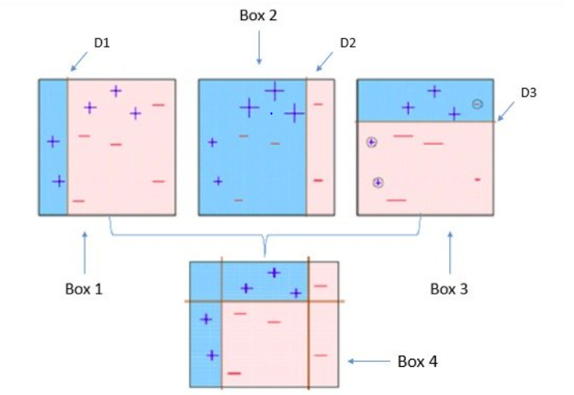
Ada Boost Algorithm
Ada boost is also known as Adaptive Boosting which uses ensemble method
An AdaBoost regressor is a meta-estimator that begins by fitting a regressor on the original dataset and then fits additional copies of the regressor on the same dataset but where the weights of instances are adjusted according to the error of the current prediction. As such, subsequent regressors focus more on difficult cases.

Slide 2
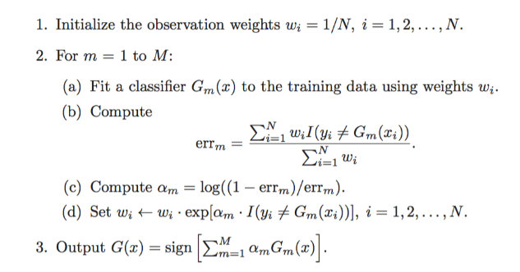
Ada Boost Algorithm
Boosting : Sequential tree growing with weighted samples
Bagging : Parallel tree growing with subsamples

Slide 3
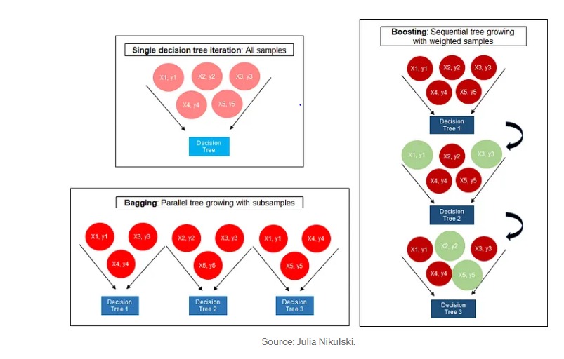
Ada Boost Algorithm

Slide 4
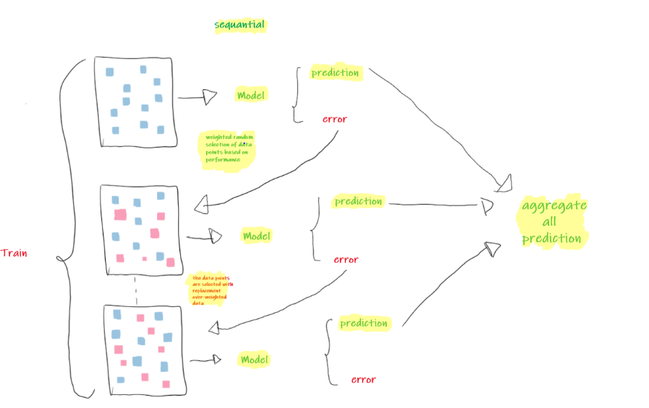
Sequential Ada Boost Algorithm

Slide 5
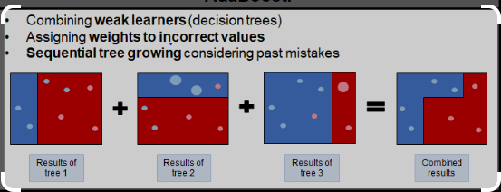
Sequential Ada Boost Algorithm

Slide 6
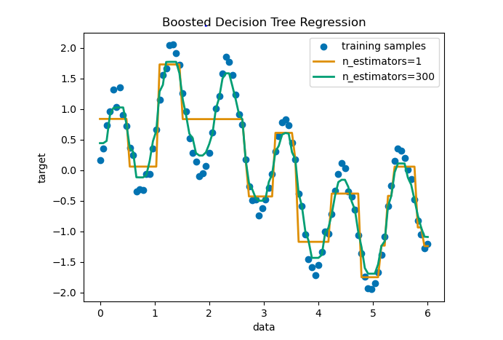
Decision Tree Regression with AdaBoost

